Slide 1
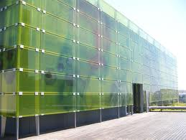
GB2.0
GOLDENBRAID 2.0: A comprehensive DNA assembly framework for Plant Synthetic Biology and Molecular Farming
Plant Genomics and Biotechnology Group
IBMCP (CSIC-UPV), Valencia

Slide 2

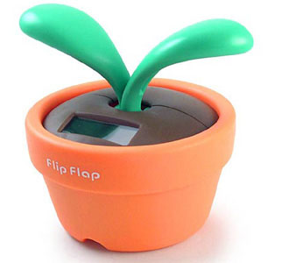
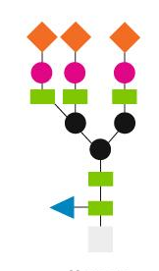
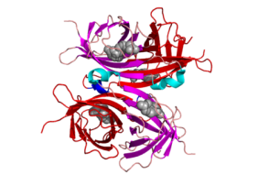
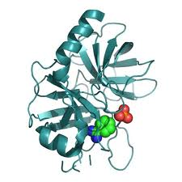
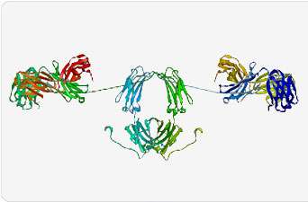
The transit from Biotechnology to Synthetic Biology
GB2.0
MOLECULAR FARMING
Plant Genetic Engineering
Single gene traits
Plant Synthetic Biology
Multigenic traits
www.gbcloning.org

Slide 3
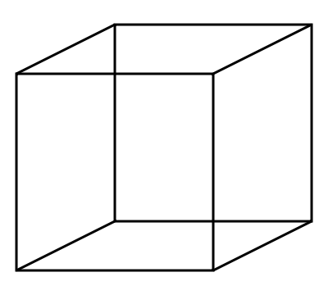
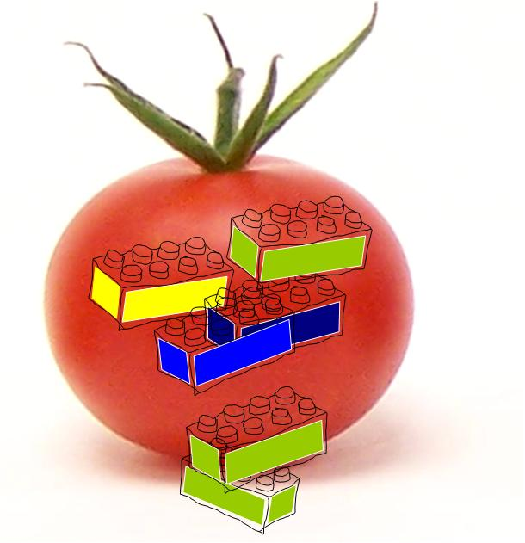
The benefits of Modular Design
GB2.0
FLEXIBILITY
INTERCHANGEABILITY
STANDARDIZATION
HIGH-THROUGHPUT
www.gbcloning.org

Slide 4


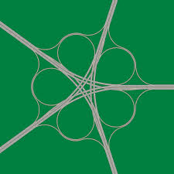



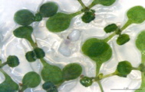
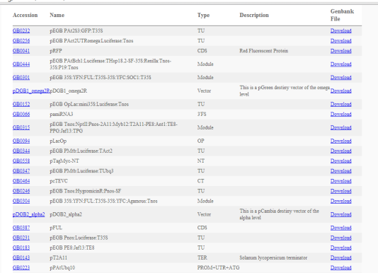
The GoldenBraid 2.0 Framework
GB2.0
Grammar
Software tools
GB2.0
Interchangeability
Database
Functionally-tested genetic modules
www.gbcloning.org

Slide 5
The chemistry behind GoldenBraid
GB2.0
Type IIS restriction enzymes
ctcgag
nnnn cctgag
Type II enzyme
Type IIS enzyme
Type II enzyme
Type IIS enzyme
GoldenBraid 1.0:
Sarrion-Perdigones, A., E.E. Falconi, S.I. Zandalinas, P. Juarez, A. Fernandez-Del-Carmen, A. Granell, and D. Orzaez,. PLoS One, 2011. 6(7): p. e21622
GoldenGate:
Engler, C., R. Gruetzner, R. Kandzia, and S. Marillonnet, PLoS One, 2009. 4(5): p. e5553.
Engler, C., R. Kandzia, and S. Marillonnet, PLoS One, 2008. 3(11): p. e3647.
www.gbcloning.org

Slide 6
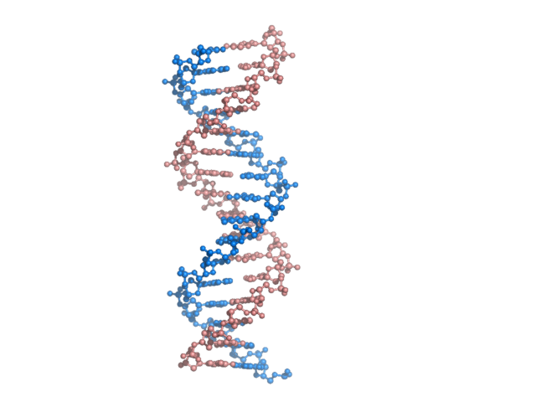




The chemistry behind GoldenBraid
GB2.0
AATG
GCTT
Prefix
Suffix
GGAG
AATG
GCTT
CGCT
PROMOTER + UTR +ATG
CDS
TERMINATOR
www.gbcloning.org

Slide 7
GB 2.0: analogy with the grammar
GB2.0
e
s
n
d
t
r
d
a
u
n
www.gbcloning.org

Slide 8
GB 2.0: analogy with the grammar
GB2.0
it
you
do
!
not
understand
www.gbcloning.org

Slide 9
GB 2.0: analogy with the grammar
GB2.0
you do not understand it!
If you can’t compute it
www.gbcloning.org

Slide 10
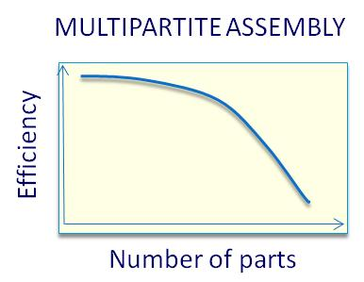
The GB 2.0 assembly strategy
GB2.0
Basic Genetic elements
GB supports multipartite assemblies of several (up to 8) small DNAparts in a single reaction to create a transcriptional units
Multipartite
GBparts
Transcriptional Units
Binary,
Iterative,
Genetic Modules
GB works as a double iterative loop that allows the stepwise assembly of new TUs indefinitely.
www.gbcloning.org

Slide 11
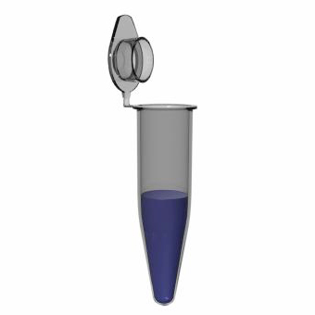
The 4 pDGBs give a double-loop structure (braid)
GB2.0
1
LacZ
2
3
1
LacZ
2
3
pDGB α1
pDGB Ω1
α LEVEL (BsaI reactions)
Ω LEVEL
(BsmBI reactions)
3
1
LacZ
2
3
1
LacZ
2
pDGB α2
pDGB Ω2
www.gbcloning.org

Slide 12





GB 2.0 software tools
GB2.0
SEQUENCE
GB Domesticator
GB part
GB part
GB part
GB part
GB TU Assembler
GB database
GB TU1
GB TU2
GB Binary Assembler
GB Module
www.gbcloning.org

Slide 13
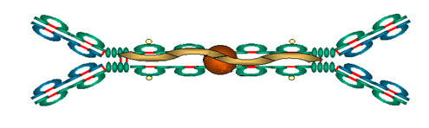
GoldenBraid 2.0: building a secretory IgA
GB2.0
35S
SP
VH
CH
TNos
35S
SP
VL
CL
TNos
35S
SP
SC
TNos
35S
SP
Jchain
TNos
www.gbcloning.org

Slide 14
The GB2.0 workflow
GB2.0
PARTS and SUPERPARTS
GCTT
CGCT
TNos
TNos
TRANSCRIPTIONAL UNIT
hSC
AGCC
SC
GCTT
MULTIPARTITE ASSEMBLY
DOMESTICATION
35S
SP
SC
TNos
35S
GGAG
35S
AATG
SP
AATG
AGCC
SP
BINARY
ASSEMBLY
GENETIC
MODULE
35S
SP
SC
TNos
35S
SP
Jchain
TNos
www.gbcloning.org

Slide 15
The Grammar
GB2.0
- Transcriptional Unit
01
02
03
11
12
13
14
15
16
17
21
5’ NT
TRANSCRIBED REGION
3’ NT
5´UTR
LINK
TL1
TL2
TL3
TL4
3´UTR
GGAG
TGAC
TCCC
TACT
CCAT
AATG
AGCC
TTCG
GCAG
GCTT
GGTA
CGCT
01-02-03-11-12 (PROM+UTR+ATG)
13 (SP)
14-15-16 (CDS)
17-21 (TER)
35S
SP
SC
TNos
- English sentence
SUBJECT
PREDICATE
STOP
ART
NOUN
VERB
ART
ADJ
NOUN
Biotechnology
has
a
potential
huge
.
www.gbcloning.org

Slide 16
Domestication of the Secretory Component
GB2.0
AGCC
GCTT
SC
www.gbcloning.org

Slide 17

Multipartite Assembly of the TU encoding the SC
GB2.0
35S
SP
SC
TNos
GB DB
GB DB
GB DB
DOMESTICATED
www.gbcloning.org

Slide 18
Binary Assembly of the TUs encoding the SC and the JC
GB2.0
3
1
LacZ
2
TU SC
pDGB_Ω2
1
3
TU JC
3
2
3
2
www.gbcloning.org

Slide 19
Binary Assembly of the preassembled genetic modules
GB2.0
1
LacZ
2
3
pDGB_α1
TU HC
TU LC
1
3
1
3
TU SC
TU JC
3
2
www.gbcloning.org

Slide 20
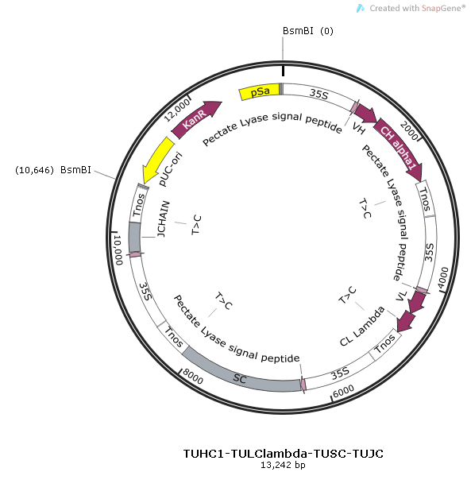
Secretory IgA construction
GB2.0
4 TUs: 13kb
www.gbcloning.org

Slide 21
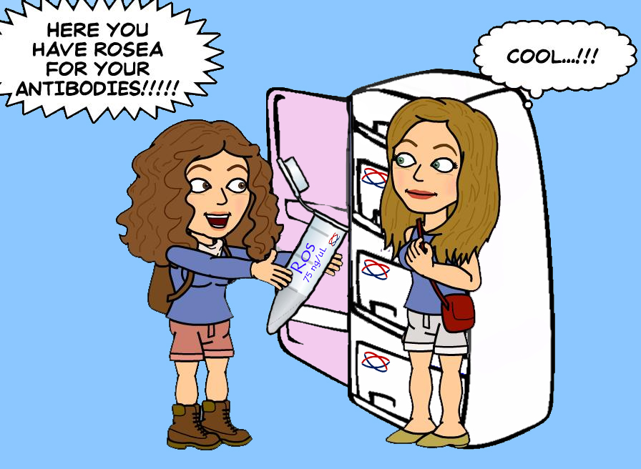
The major benefit of GB2.0 framework: interchangeability
GB2.0
Every story has an end, but with GB every ending is just a new beginning.
www.gbcloning.org

Slide 22
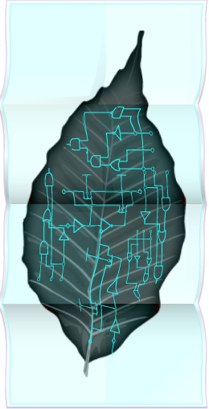
Conclusions
GB2.0
To learn more:
www.ibmcp.upv.es/FGB
www.gbcloning.org
Hands-on course on multiple gene assembly technologies for metabolic engineering and fruit biotechnology
Valencia (Spain), September 9th to 13th, 2013
Organized by COST Actions FA1006 (PlantEngine) and FA1106 (QualityFruit)
http://www.plantengine.eu/node/156; http://qualityfruit.inp-toulouse.fr/en/training/dna-assembly.html
GB2.0 is a convenient framework for Plant Synthetic Biology, including Molecular Farming and Metabolic Engineering
www.gbcloning.org

Slide 23
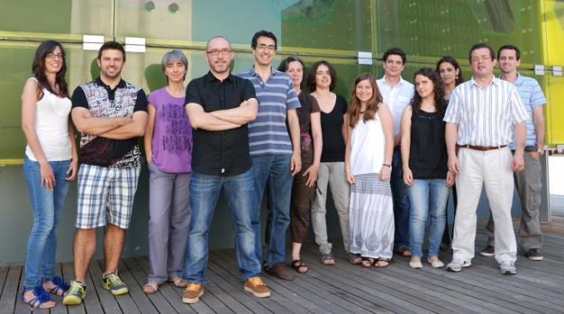


Fruit genomics and Biotechnology Group.
www.ibmcp.upv.es/FGB
IBMCP
Alejandro Sarrión
Javier Forment
Paloma Juárez
Estefanía Huet
Asun Fernández
Jose Manuel Julve
Diego Orzáez
COMAV
Peio Ziarsolo
Jose Blanca
THANK YOU!

